Slide 1
Simply Accessing Information Through Media on the Web

Slide 2
#1. Getting Involved on Twitter
Open Twitter by typing “twitter.com” in your browser
Log in to your existing account, or create one

Slide 3
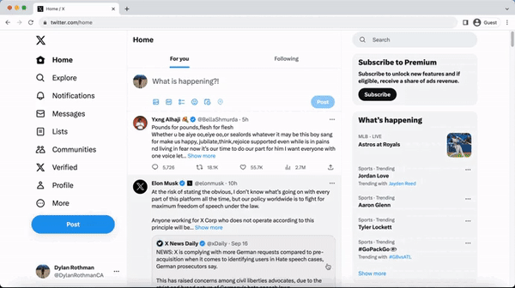
Navigate to the Search Bar
Type in “Calabasas”
Be sure to follow and click the bell to receive notifications

Slide 4
#2. Joining the Community on Facebook
Open Facebook by typing “facebook.com” in your browser
Log in to your existing account, or create one

Slide 5
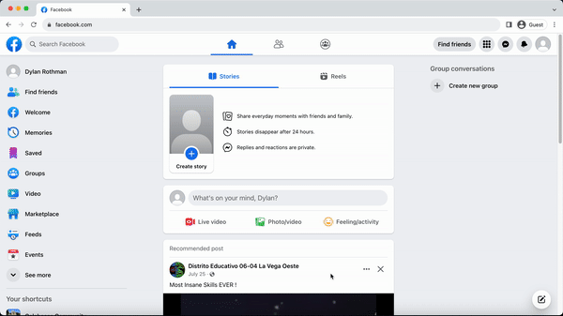
Navigate to the Search Bar
Type in “Calabasas” to find your local group
Be sure to click “Join group” to be added to the community

Slide 6
Important Notes
You may have to request to join
You may have to allow notifications on your device

