Slide 1
CLICK IN ANY OF THESE TEXT BOXES TO CHANGE THE TEXT SEEN IN THIS TEMPLATE. CUSTOMIZE IT TO FIT YOUR PERSONAL NEEDS.
CLICK IN ANY OF THESE TEXT BOXES TO CHANGE THE TEXT SEEN IN THIS TEMPLATE. CUSTOMIZE IT TO FIT YOUR PERSONAL NEEDS.
CAPTURE
CALABASAS
PHOTO CONTEST
SPRING 2023 WINNERS

Slide 2
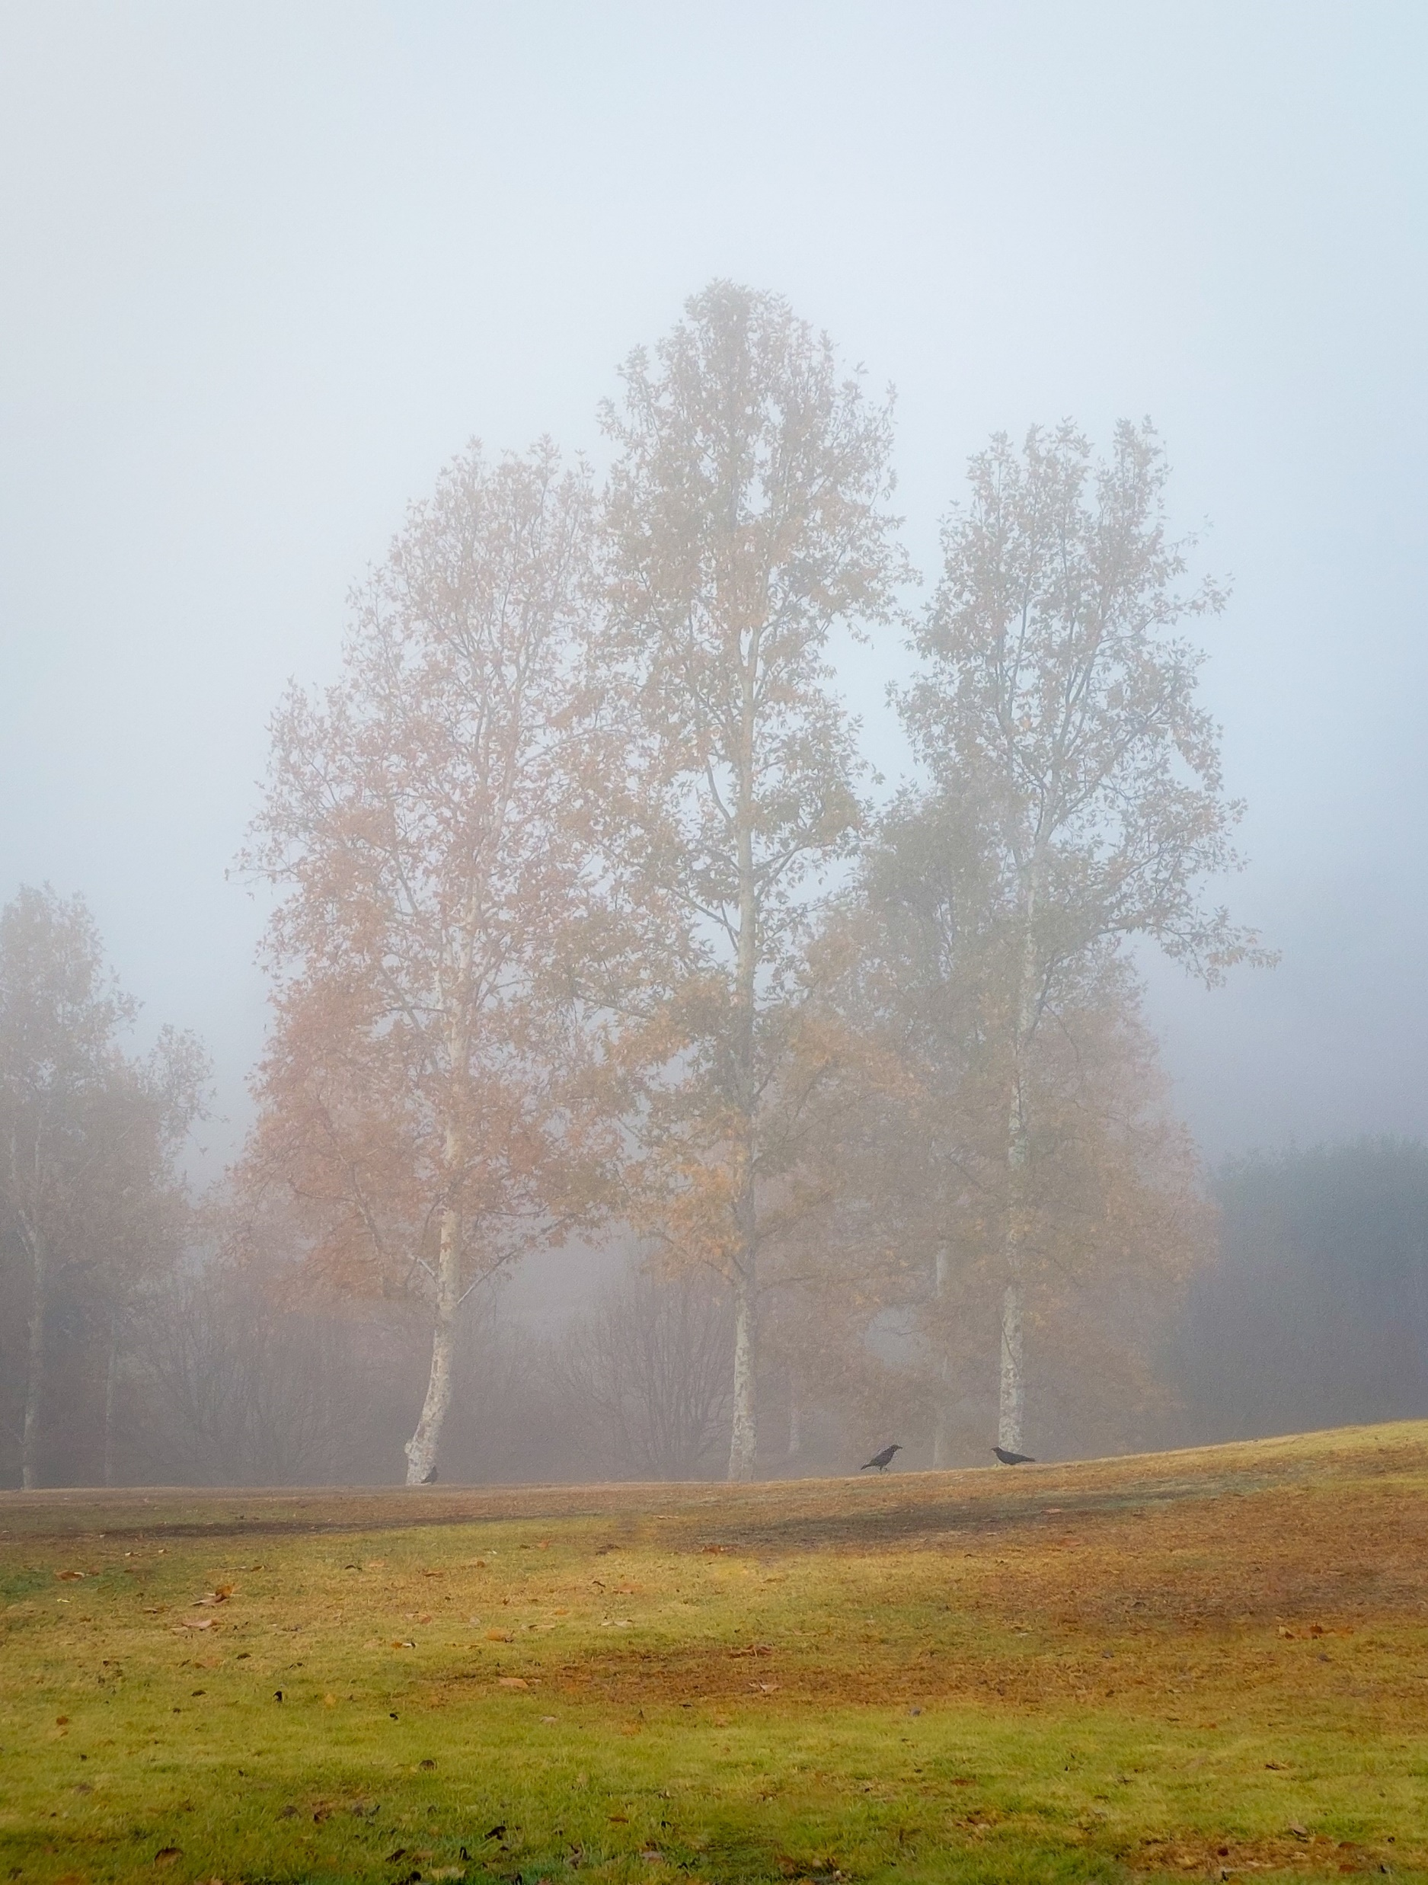
To change this dual image.
1- Right Click on top of either image.
2- Choose “Change Picture” 3- Choose option “From File” 4- Locate file and Open
Hilary Chute
First Place
Category: Parks Make Life Better
“Foggy morning at DeAnza Park”

Slide 3
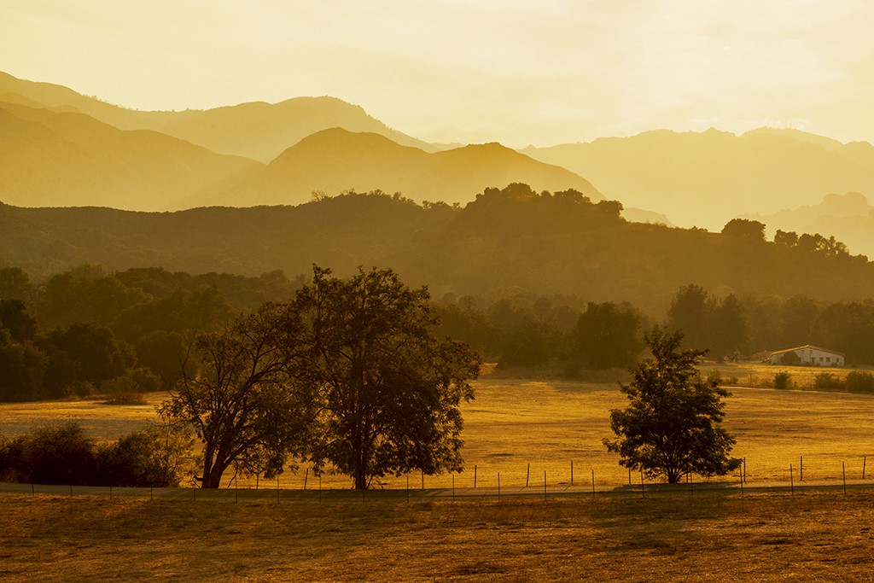
Gayle L. Pepper
First Place
Category: Open Space
“Autumn evening at King Gillette Ranch”

Slide 4
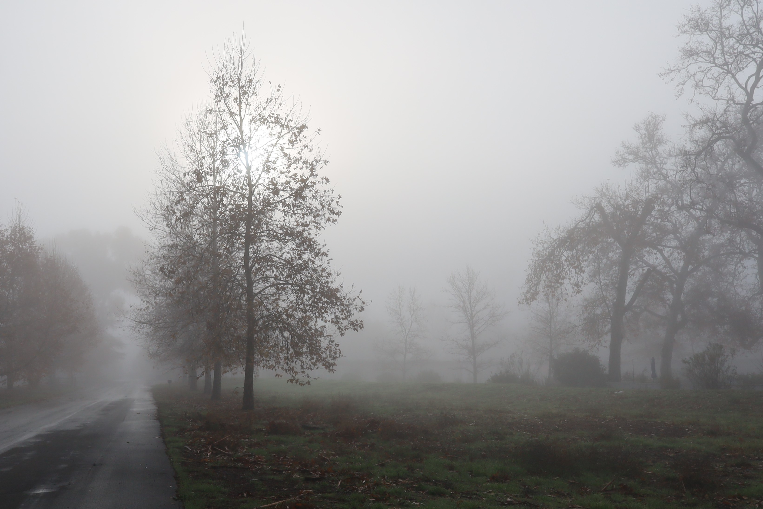
Sophia Wong
Second Place
Category: Open Space
“Misty Moody Morn”

Slide 5
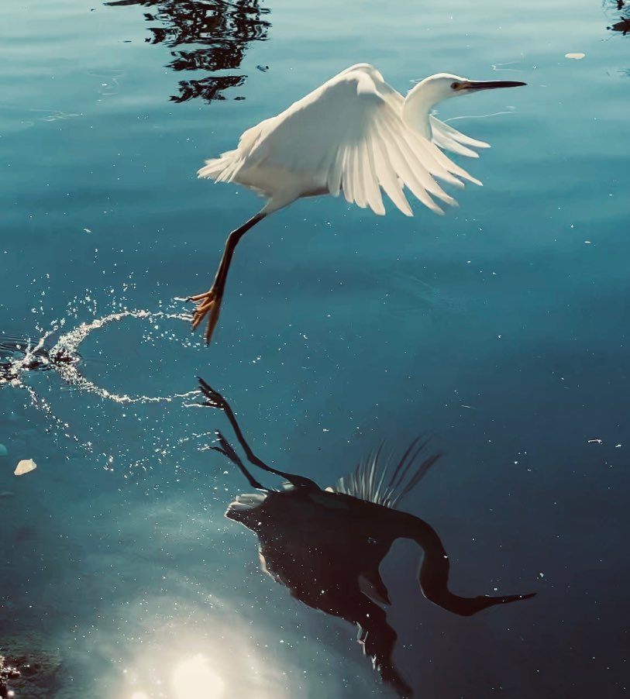
To change this dual image.
1- Right Click on top of either image.
2- Choose “Change Picture” 3- Choose option “From File” 4- Locate file and Open
Judith A. Colgate
Second place
Category: Parks Make Life Better
“Beautiful egret taking flight over Calabasas Lake”

Slide 6
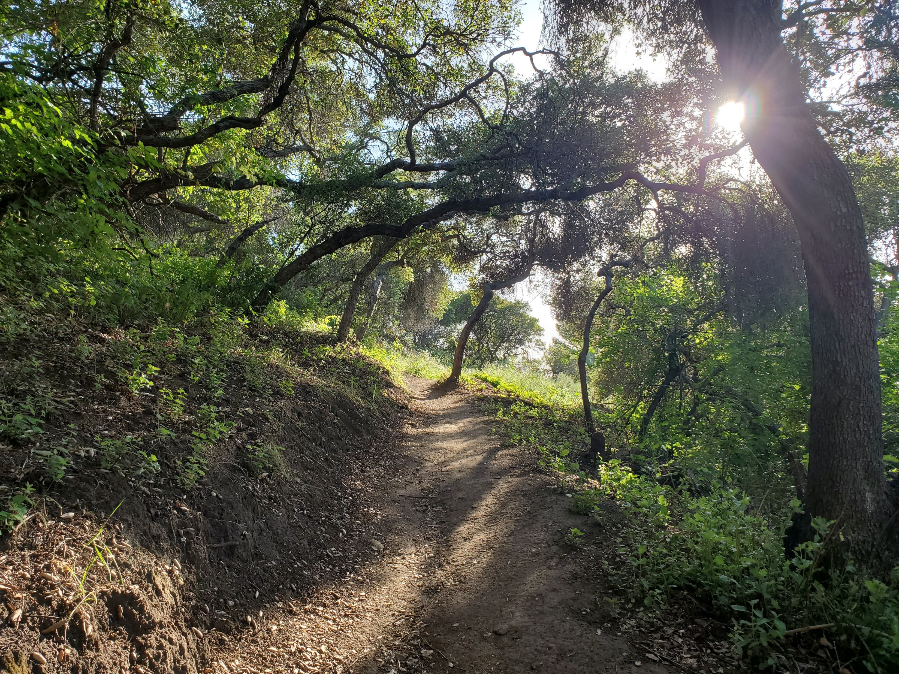
Raffi Kahwajian
Third Place
Category: Open Space
“Tree-lined path”

Slide 7
CLICK IN ANY OF THESE TEXT BOXES TO CHANGE THE TEXT SEEN IN THIS TEMPLATE. CUSTOMIZE IT TO FIT YOUR PERSONAL NEEDS.
CLICK IN ANY OF THESE TEXT BOXES TO CHANGE THE TEXT SEEN IN THIS TEMPLATE. CUSTOMIZE IT TO FIT YOUR PERSONAL NEEDS.
Congratulations!

