Slide 1
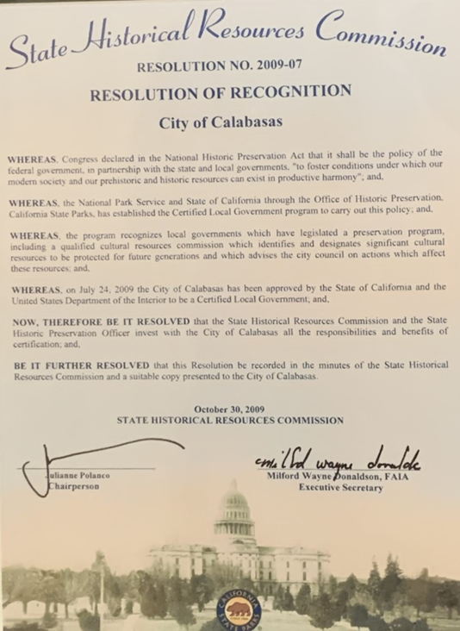
Historic Preservation Commission
Certified Local Government (CLG) Program
FY 2020 – 2021 Report
Wednesday April 6, 2022

Slide 2
CLG Report FY 2020 - 2021
Program Created by:
National Historic Preservation Act of 1966
In Partnership with:
The California Office of Historic Preservation (OHP)
The National Park Service (NPS)
Purpose:
To encourage local government participation in identification, evaluation, registration, and preservation interests and concerns.
Calabasas Background:
2009 – Established CLG
(7) Designated Historic Properties
(16) Eligible Historic Properties

Slide 3
What does CLG mean for the HPC?
As a Certified Local Government for Historic Preservation (a CLG) since 2009, the City of Calabasas is empowered with certain responsibilities and authorities under the federal and state laws governing historic resource protection.
To help ensure that we can properly carry out our obligations and duties as a CLG, every year the members of the City’s Historic Preservation Commission are required to receive a couple hours of training and education on historic preservation law, applicable rules and guidelines, architecture and architectural history, and other matters relevant to historic preservation.

Slide 4
Project Review - Commission Responsibilities
Evaluation
Recommendation
Ultimate Decision
The Secretary of the Interior’s Standards and Guidelines are the basis for how the City reviews historic resources and projects.
Reviewers must consider the most appropriate treatment for (or in relation to) the subject resource, and whether the proposed work will accomplish the appropriate treatment in a manner consistent with the standards and guidelines.

Slide 5
CLG Annual Report Sections
Minimum Requirements for Certification:
Local legislation for the designation and protection of historic properties
Historic Preservation Commission members and Staff qualifications review
Survey and inventory of properties
Public participation in the local historic preservation program
Additional information for National Park Service
CLG feedback on trainings
Attachments
Commissioner & Staff Resumes
Meeting minutes from the report period
Publications

Slide 6
Goals, Oct 2020 – Sept 2021
Masson House - Designated
CLG reporting period goals:
Conduct an update to the historic resource survey on the previously deemed “Eligible” properties.
Perform a condition assessment on currently listed Masson House structure and research potential grant funding in preparation for future renovations &/or repairs.
Prepare nomination documents for consideration of Warner Ranch (a.k.a., “National Velvet Barn” structure as a locally designated historic landmark.
Conduct appropriateness reviews as necessary.
Warner Ranch Stables - Eligible

